Slide 1
BAFE coursework
File created on: 01.03.2023 23:19:03 GMT+1

Slide 2
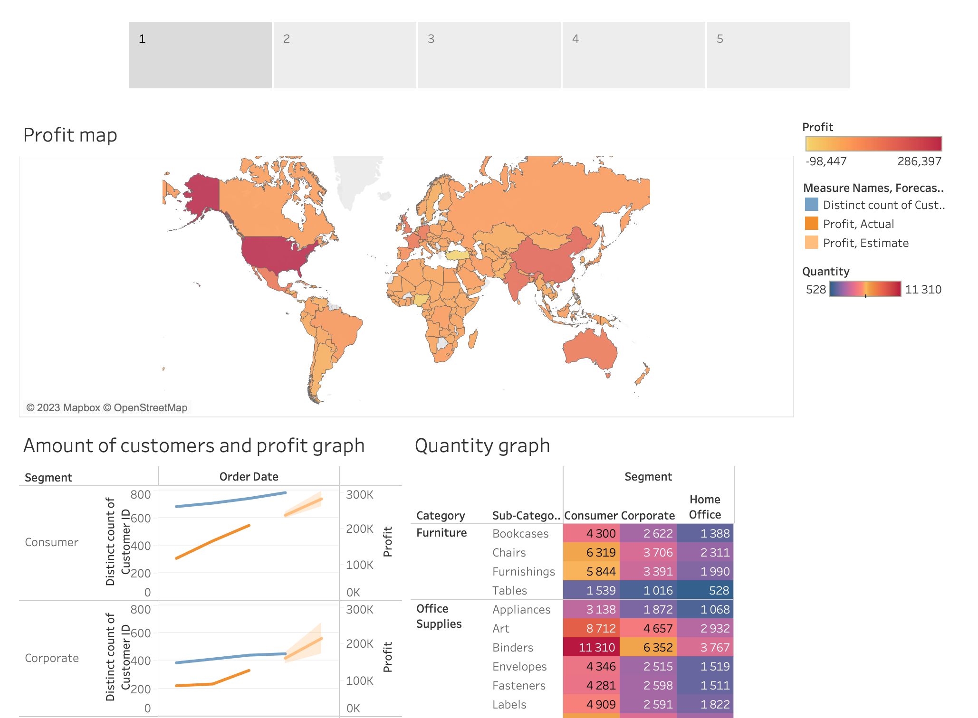

Slide 3
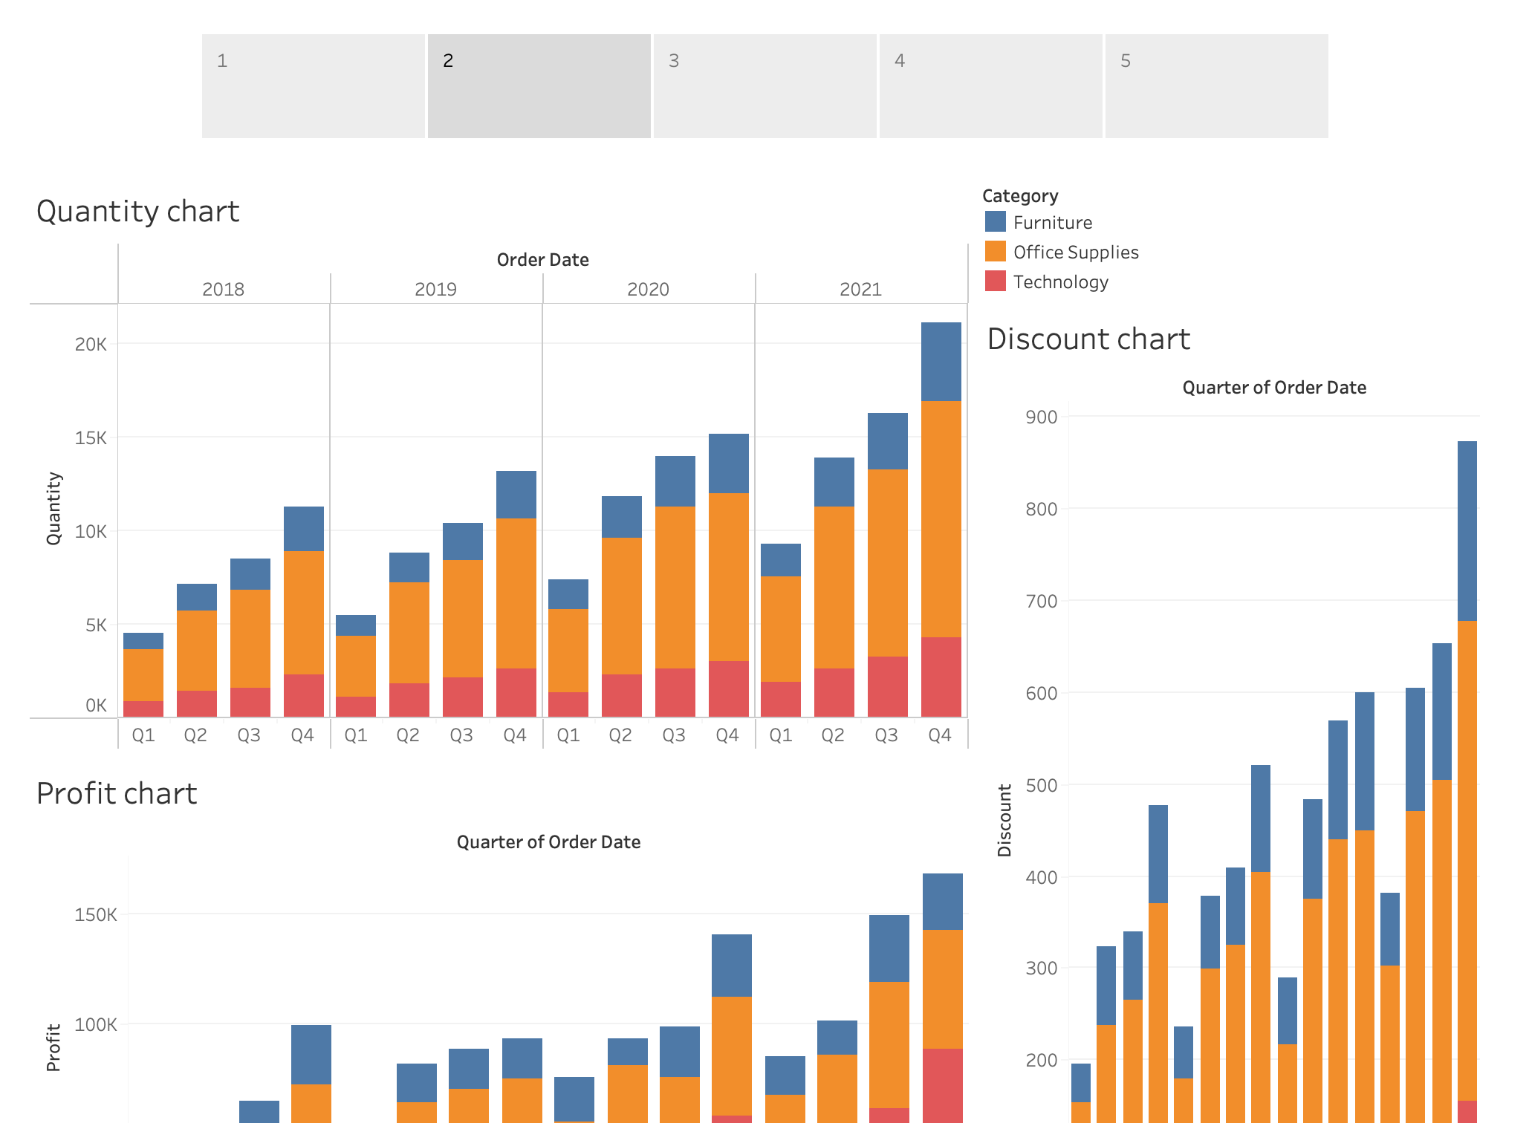

Slide 4
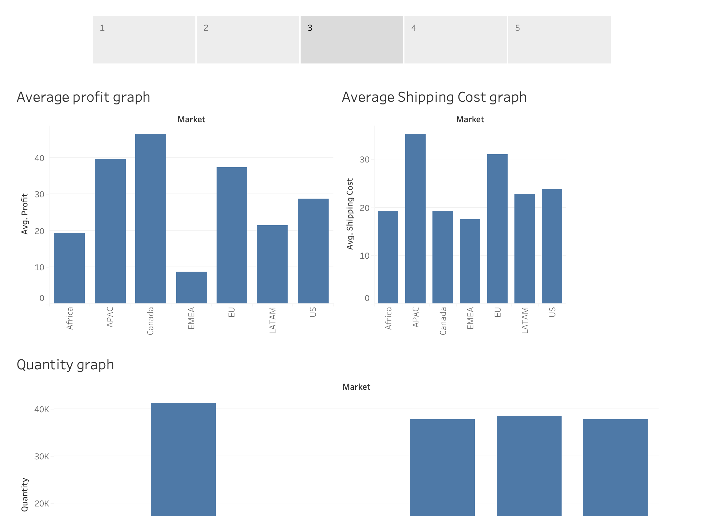

Slide 5
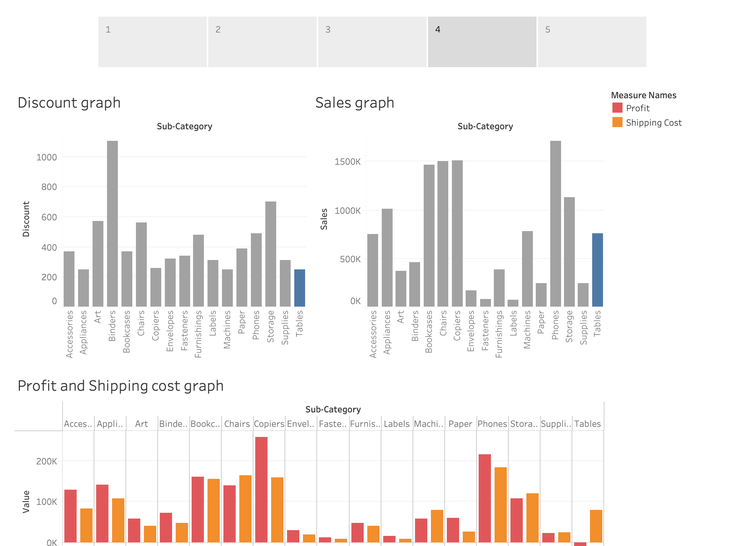

Slide 6
